Slide 1

Course Walkthrough
DevOps Live Classes

Slide 2
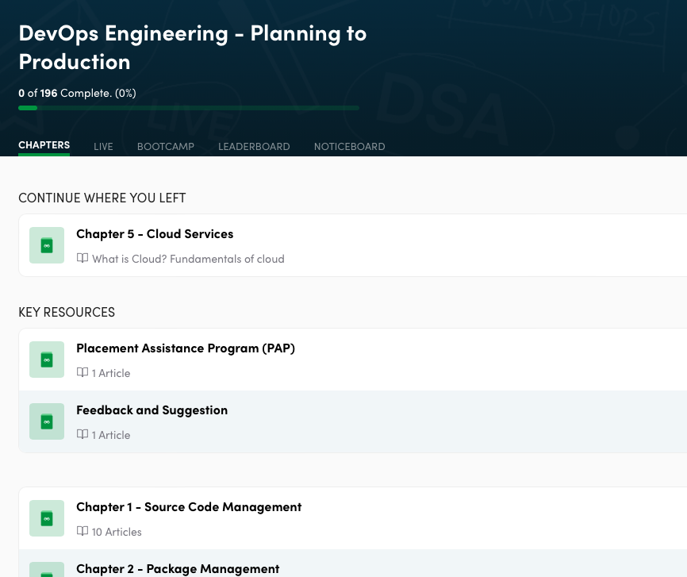
Course Structure
Chapters
Live
Contest
Leaderboard
Noticeboard

Slide 3
Chapters tab to access all the pre-recorded lectures & notes:
DevOps Notes
Source Code Management
Package Management
CICD
Container Management
Cloud services
IaS
Monitoring
Linux Notes
Git-Github Videos & MCQs

Slide 4
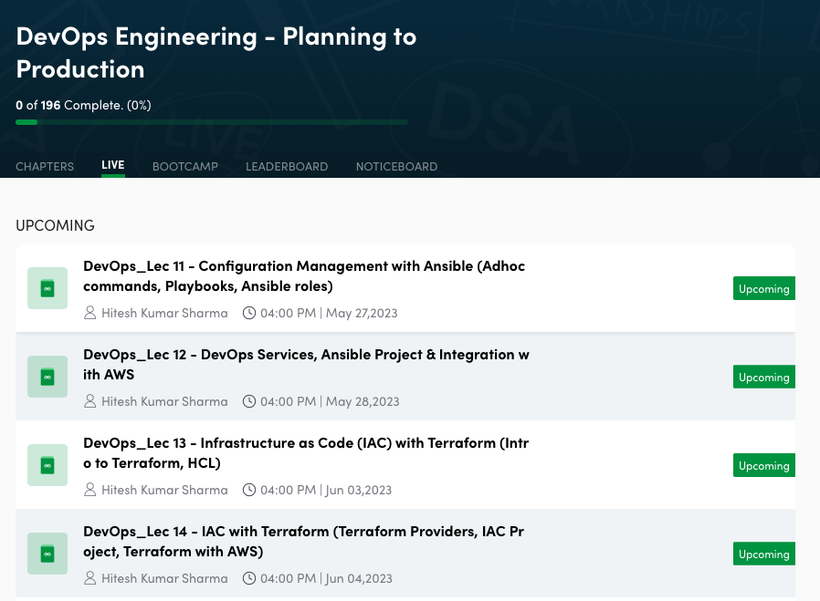
Live Classes - Upcoming

Slide 5
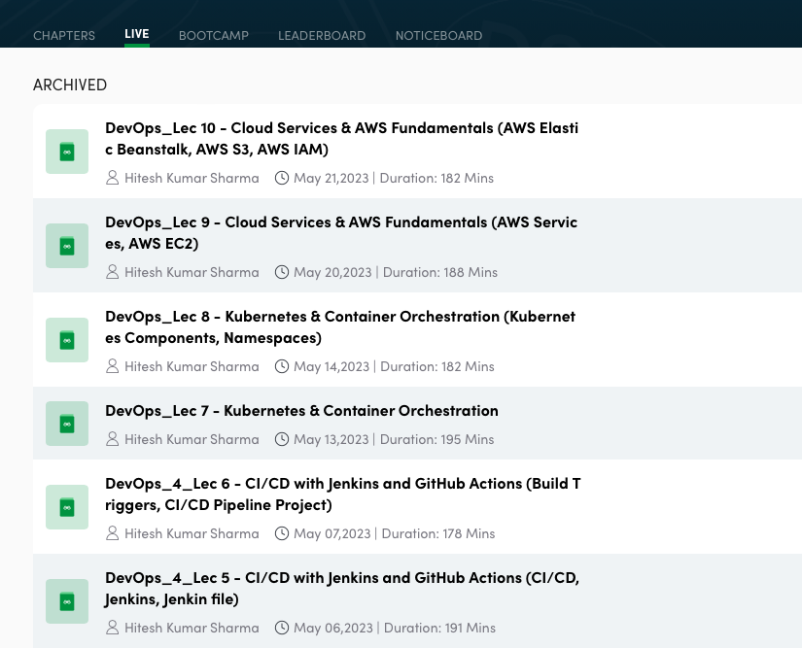
Live Classes - Archived (i.e Live Classes Recording)
Note: It will be available after 24-48 hrs of live session

Slide 6
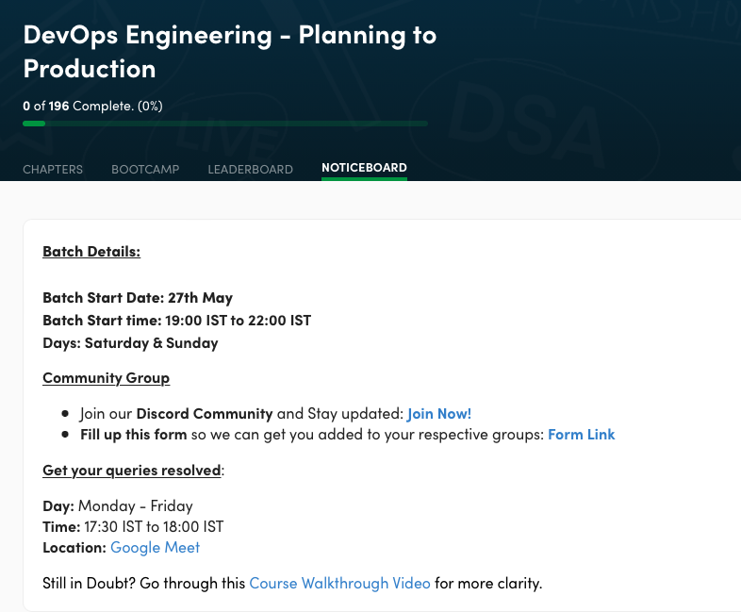
Noticeboard
It will consist of all important notifications: 1) Batch details
2) Discord Link 3) Google Meet link wherein you can 1-1 report your queries related to course. Monday - Friday (17:00 IST - 18:00 IST)

Slide 7
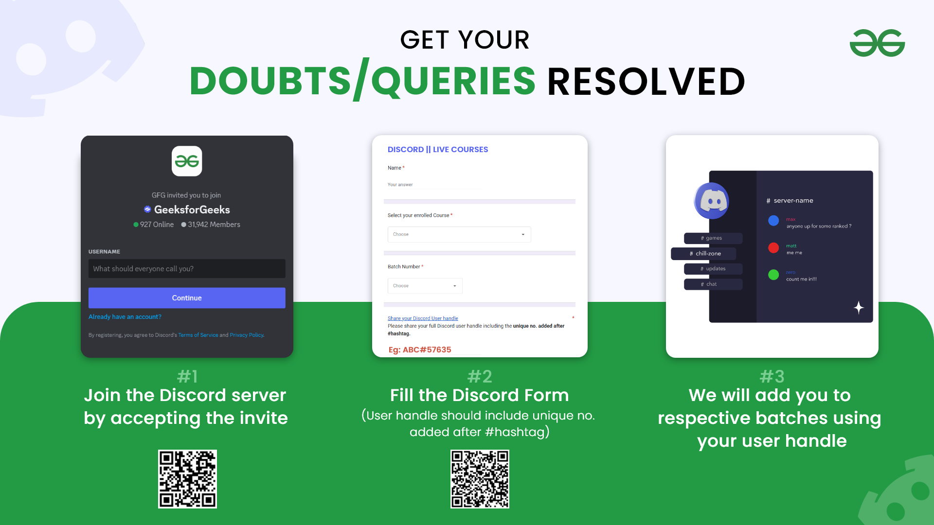
Steps to Join Discord:

Slide 8
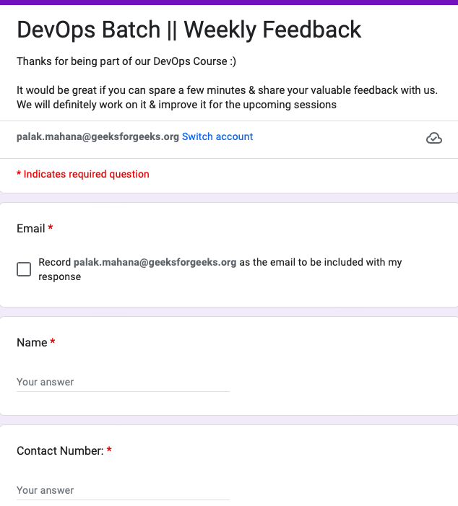
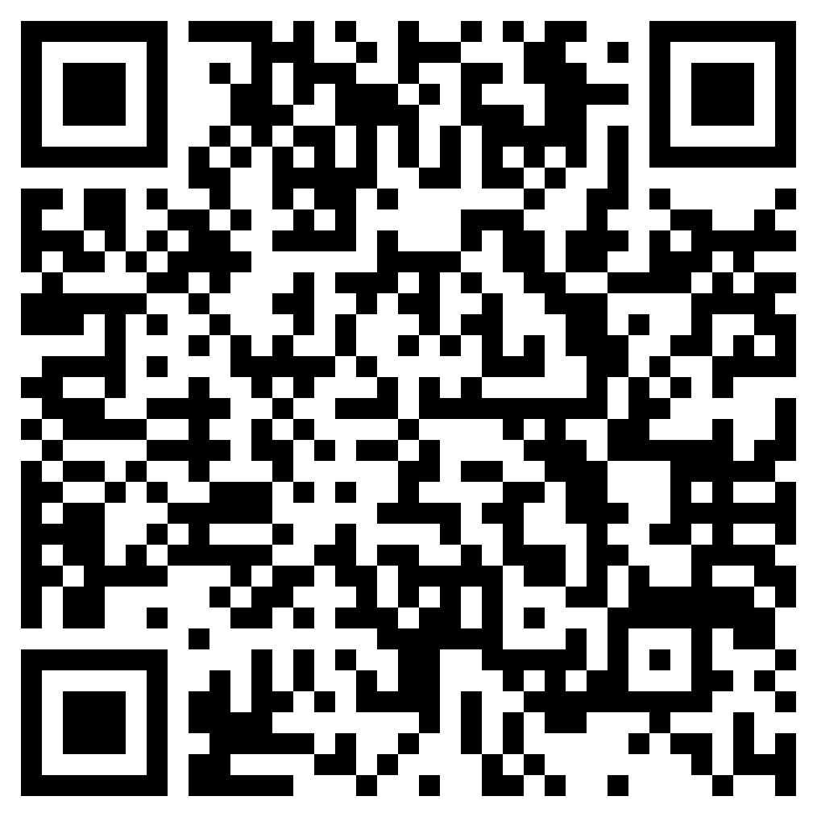
Provide Feedback after every class
Scan to share your feedback

Slide 9
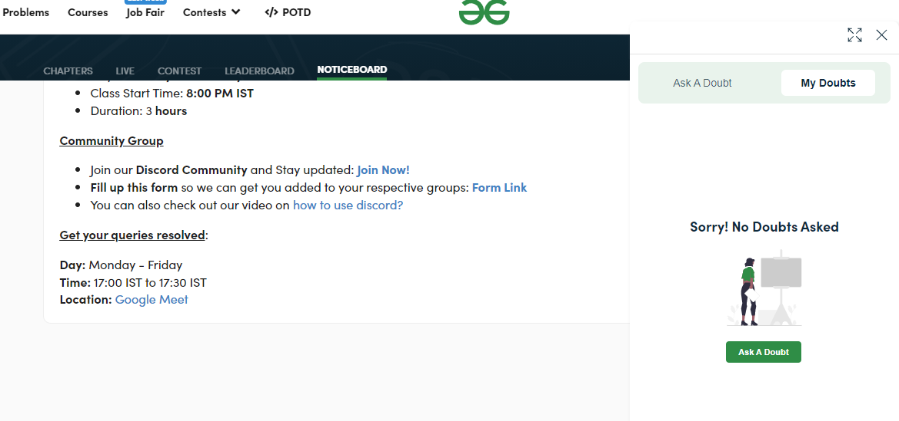
How to ask doubt?
#1 Click on ‘Ask a Doubt’

Slide 10
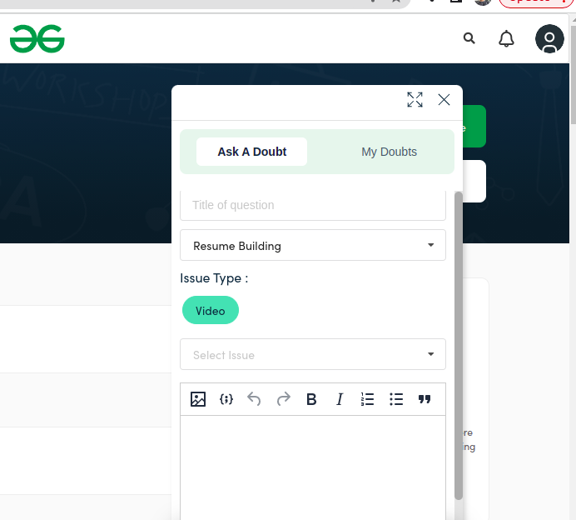
How to ask doubt?
#2 Ask a Doubt
Issue type- Video/ Problem/Quiz
TA will give your resolution
#3 For doubts related to live classes
Post your doubts in discord channel

Slide 11
Preparation for Live Classes | Week wise plan
Week 1: (Class 1 & 2)
Live Syllabus: DevOps Fundamentals (YAML, Linux), Git, GitHub, VCS, Networking
Recorded Content: Git-Github
Week 2: (Class 3 & 4)
Live Syllabus: Docker & Containerization (Docker file, Docker hub, Docker Images, Containers, Docker Command, Docker Volume, Project)

Slide 12
Preparation for Live Classes | Week wise plan
Week 3: (Class 5 & 6)
Live Syllabus: CI/CD with Jenkins and GitHub Actions (CI/CD, Jenkins, Jenkin file, Build Triggers, CI/CD Pipeline Project)
Week 4: (Class 7 & 8)
Live Syllabus: Kubernetes & Container Orchestration, Kubernetes Components, Namespaces

Slide 13
Preparation for Live Classes | Week wise plan
Week 5: Classes 9 & 10
Live Syllabus: Cloud Services & AWS Fundamentals (AWS Services, AWS EC2, AWS Elastic Beanstalk, AWS S3, AWS IAM)
Week 6: Classes 11 & 12
Live Syllabus: Configuration Management with Ansible (Adhoc commands, Playbooks, Ansible roles), DevOps Services, Ansible Project & Integration with AWS.

Slide 14
Preparation for Live Classes | Week wise plan
Week 7: Classes 13 & 14
Live Syllabus: Infrastructure as Code (IAC) with Terraform (Intro to Terraform, HCL, Terraform Providers, IAC Project, Terraform with AWS)
Week 8: Classes 15 & 16
Live Syllabus: Monitoring, Logging, and Project (Prometheus, Grafana), Creating Custom Dashboards, Major Project

